Slide 1


COFFEE SHOP
Facility Layout
Facility

Slide 2
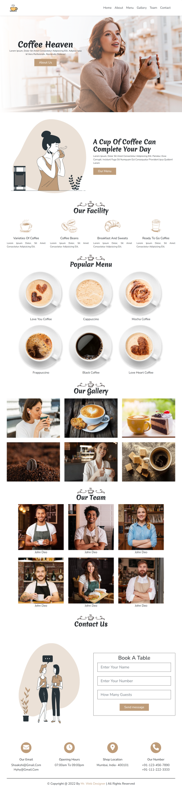
Layout Design
Components
Total number of Components
Parent Containers Of Any website
Number of Components in Coffee Shop Website
1. header
1.navBar
2. main
2.heroSection
3. footer
3.about
4.facility
5.menu
6.gallery
7.team
8.contact
9.contactIcons

Slide 3
Layout Design
Components
Total number of Components
Containers
1. header
1.navBar
2.heroSection
2. main
3.about
4.facility
5.menu
6.gallery
7.team
3. footer
8.contact
9.contactIcons

Slide 4
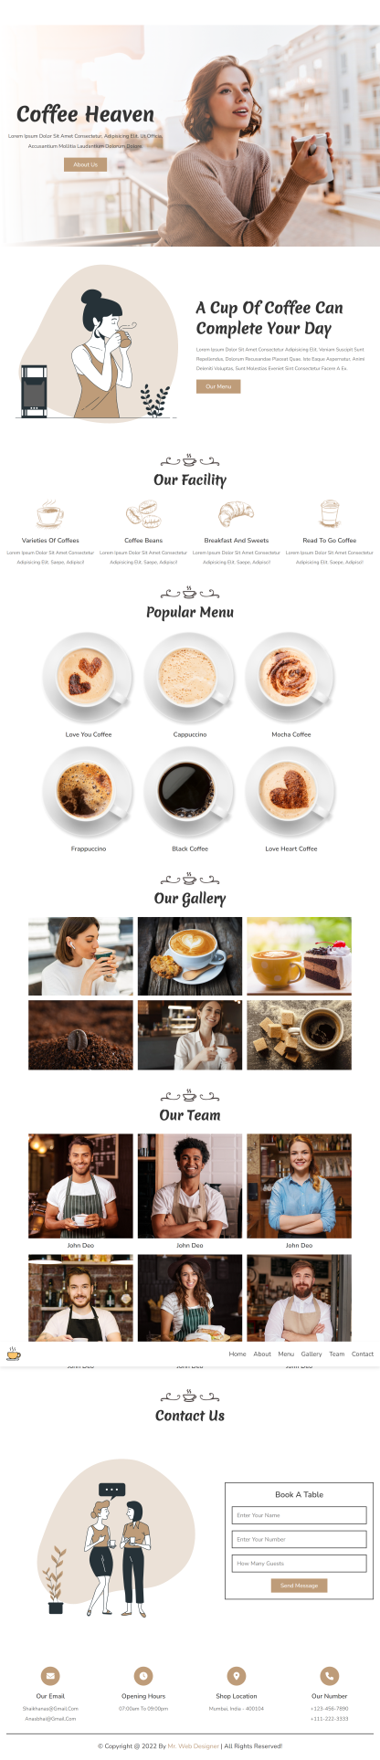
Layout Design
Components
How to Group Components into the Parent Containers
1.navBar
1. header
2.heroSection
3.about
4.facility
2. main
5.menu
6.gallery
7.team
3. footer
8.contact
9.contactIcons

Slide 5
Facility

Slide 6
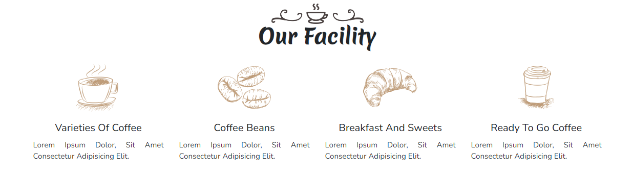
Layout Design
Containers
4.Facility

Slide 7
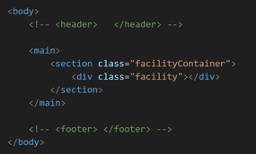
Layout Design
Containers
4.Facility
main
facilityContainer
facility

Slide 8
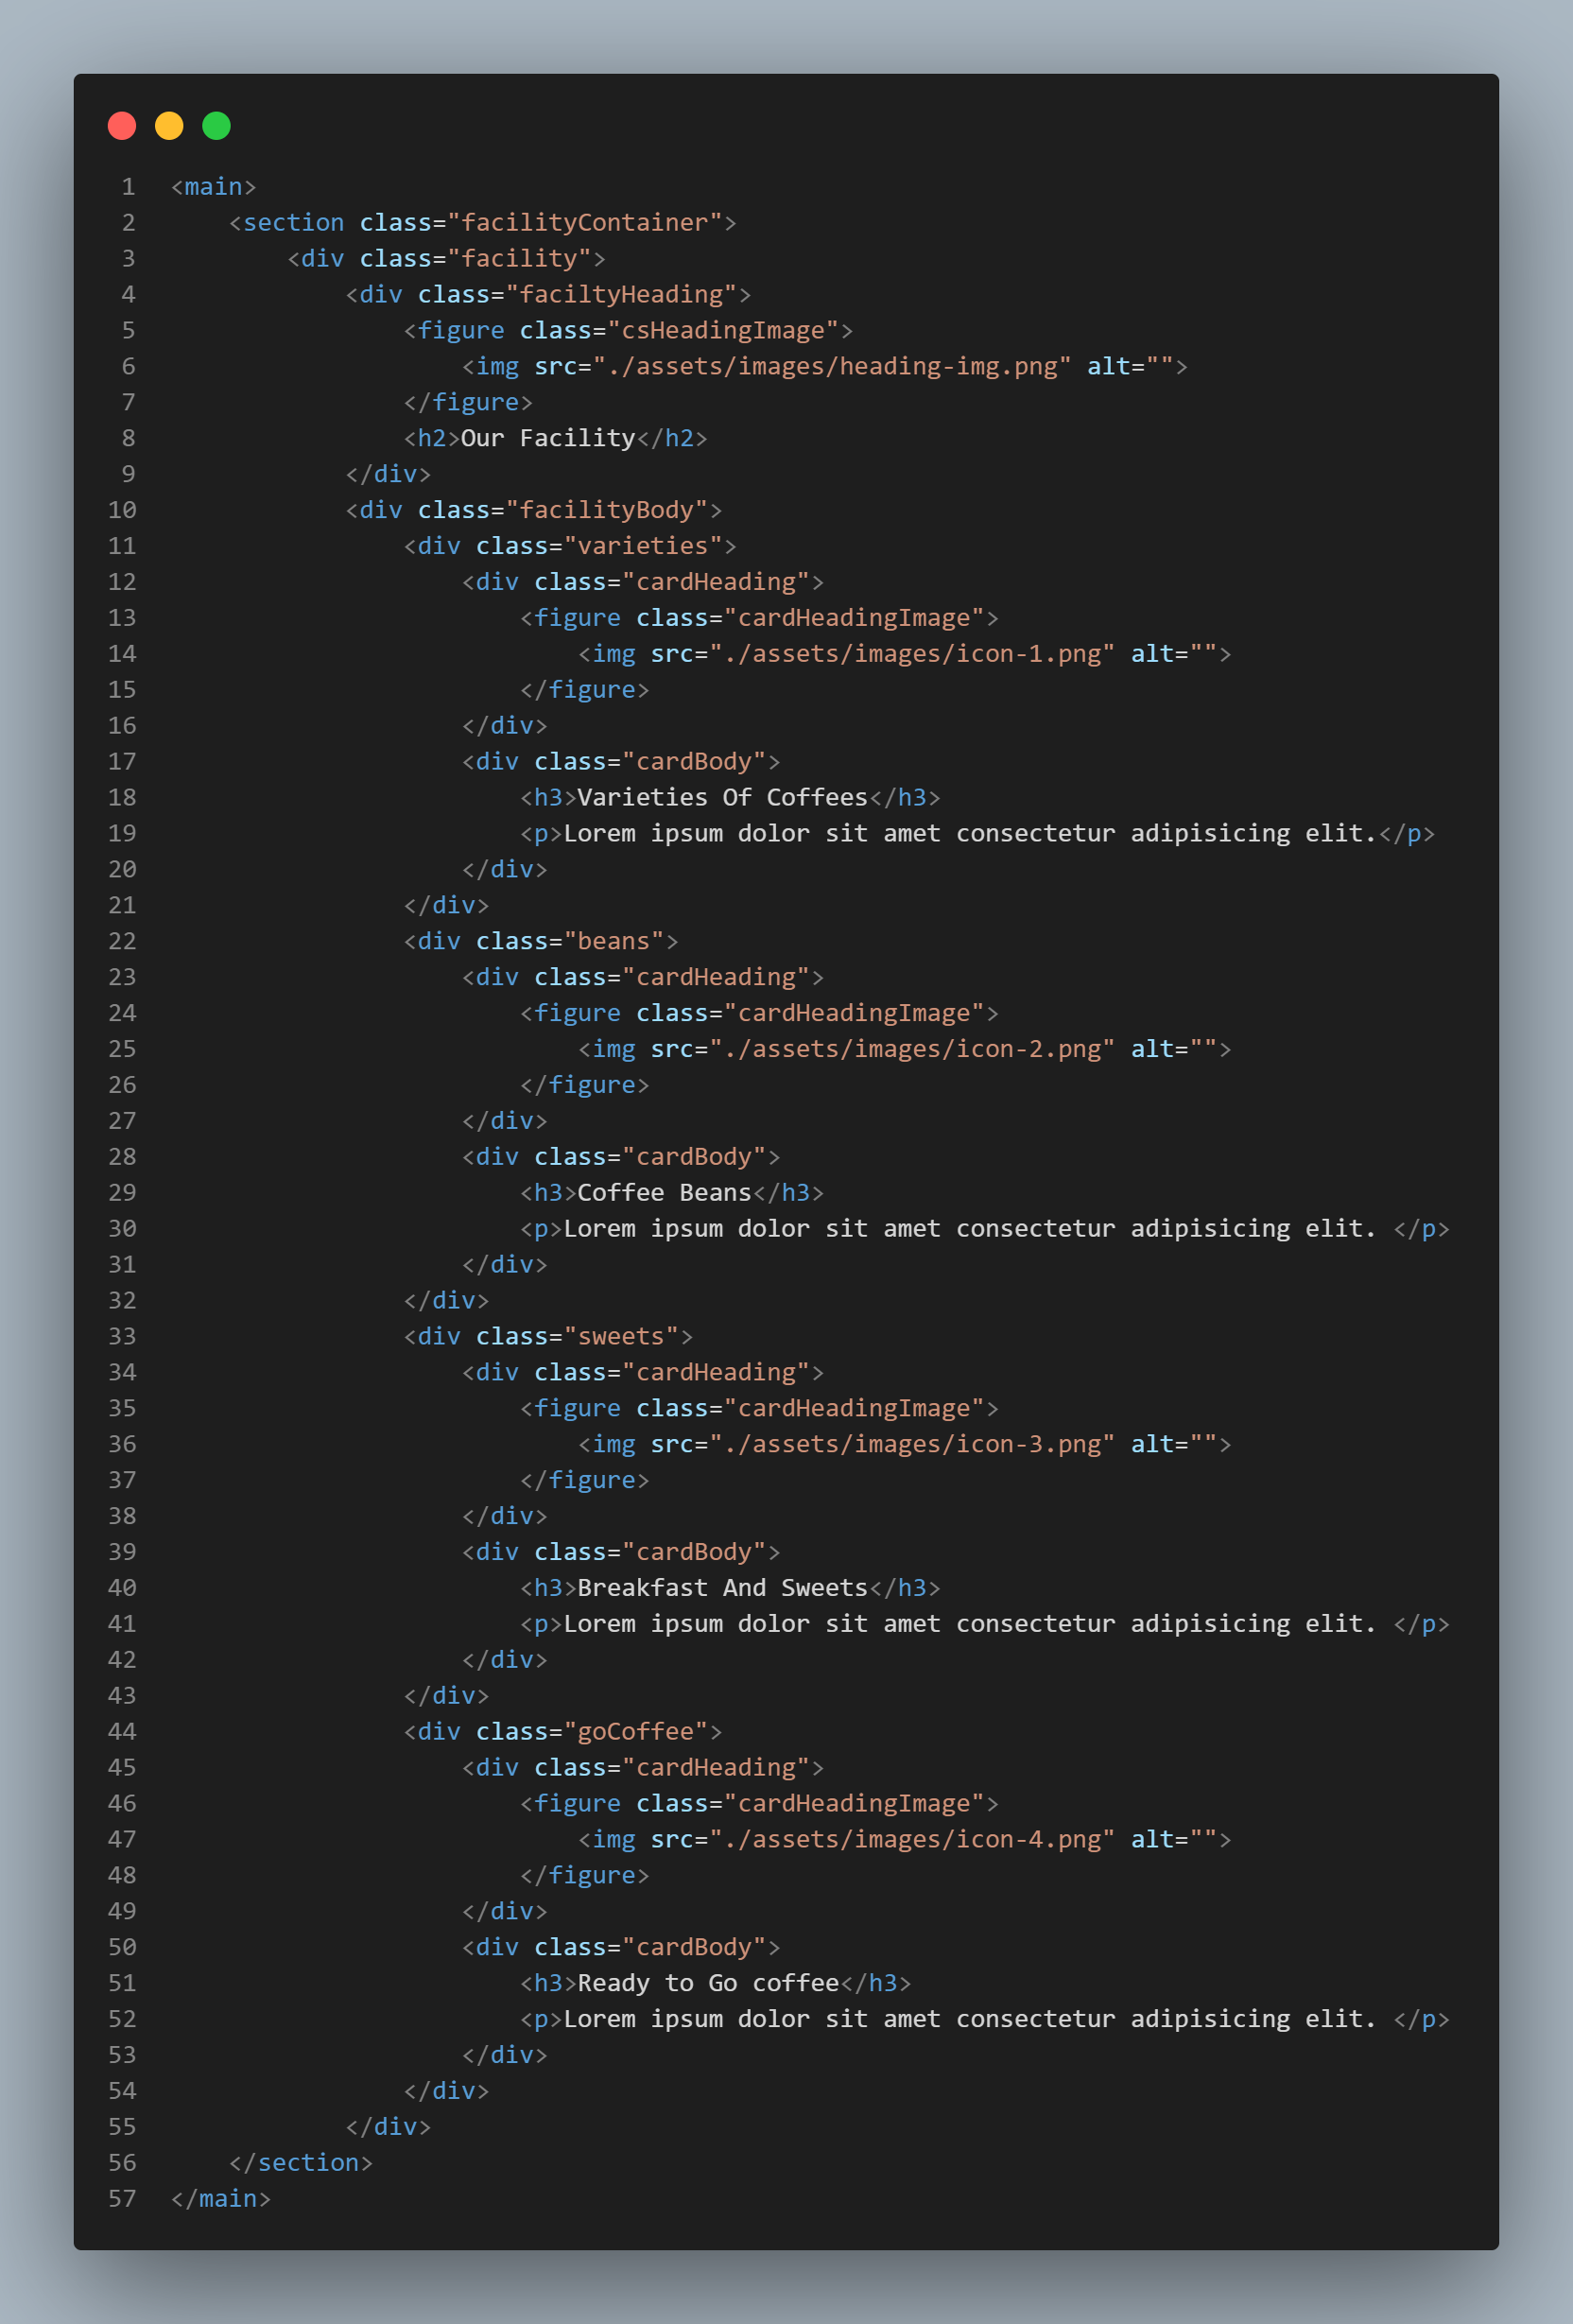
parententContainer
compontentContainer
component
componentChild
childofChild
childofchild
contentcontainer
childofchild
parentContainer
compontentContainer
component
componentchild
childofchild
contentContainer
childofchild
main
facilityContainer
facility
facilityHeadig&
facilityBody&
etc
CareBody&varaties etc..
<img> <p>&<h3>
Coffee,beans,sweet&etc.

